Slide 1


Stop and Step Away from the Data:
Rapid Anomaly Detection via
Ransom Note File Classification
Mark Mager
DEF CON 26 AI Village

Slide 2
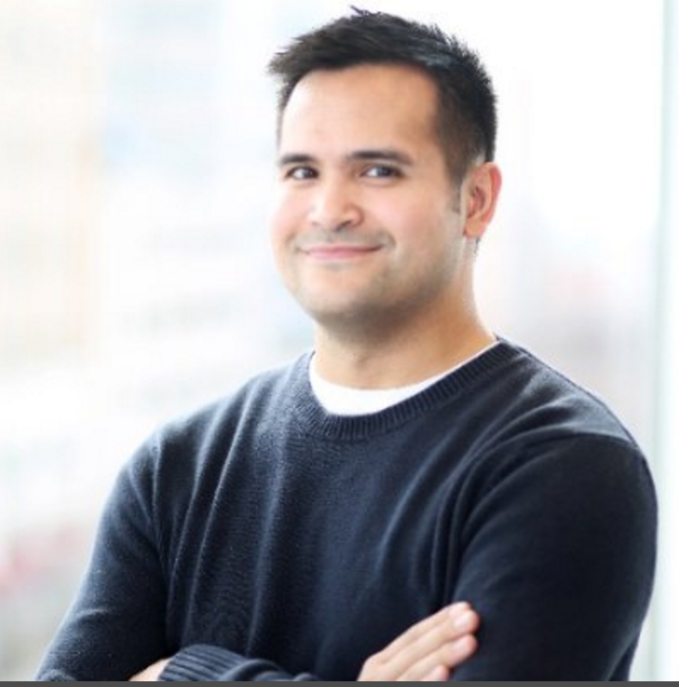
About me
I AM NOT A DATA SCIENTIST
Senior Malware Researcher at Endgame
Reverse engineer and software dev
Ransomware protection research
@magerbomb

Slide 3
agenda
Ransomware
Overview
Detection
Ransom Notes
Explorartory Research
POC Framework
Conclusion

Slide 4
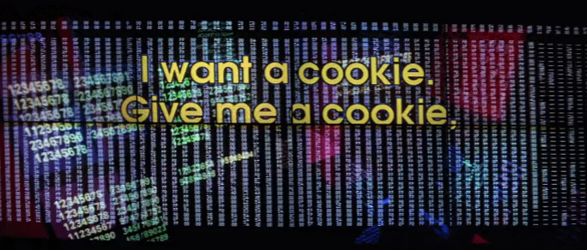
Ransomware overview
Malicious software that denies users access to their data
Most commonly through encryption
Targets common file extensions
PDF, TXT, DOC, XLS, PPT…
Two types of output
Encrypted files
Ransom notes

Slide 5

Detection methodology
Static
Heuristics / signature-based or ML-based
Benefit: preserves all data if detected!
Drawback: one chance to detect; data compromised if FN
Dynamic
Run in the background and monitor for anomalous behavior
Focus on detecting encrypted files
Benefit: ongoing chance for detect while process is active
Drawback: possible large amount of files corrupted prior to detection

Slide 6
Detection improvements
Combine static and dynamic detections
Layered security approach
Train ML model specifically to classify ransomware
Dynamically detect anomalous behavior quicker

Slide 7
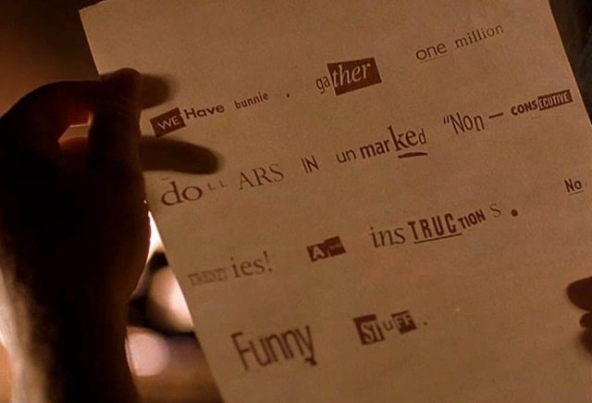
Ransom notes
Files written to solicit ransom payment
Multiple file types
Plain text: TXT
Formatted / rich text: HTML, RTF
Images: JPG, PNG, BMP
Typically one of the first files written to disk
Sometimes written to every directory

Slide 8
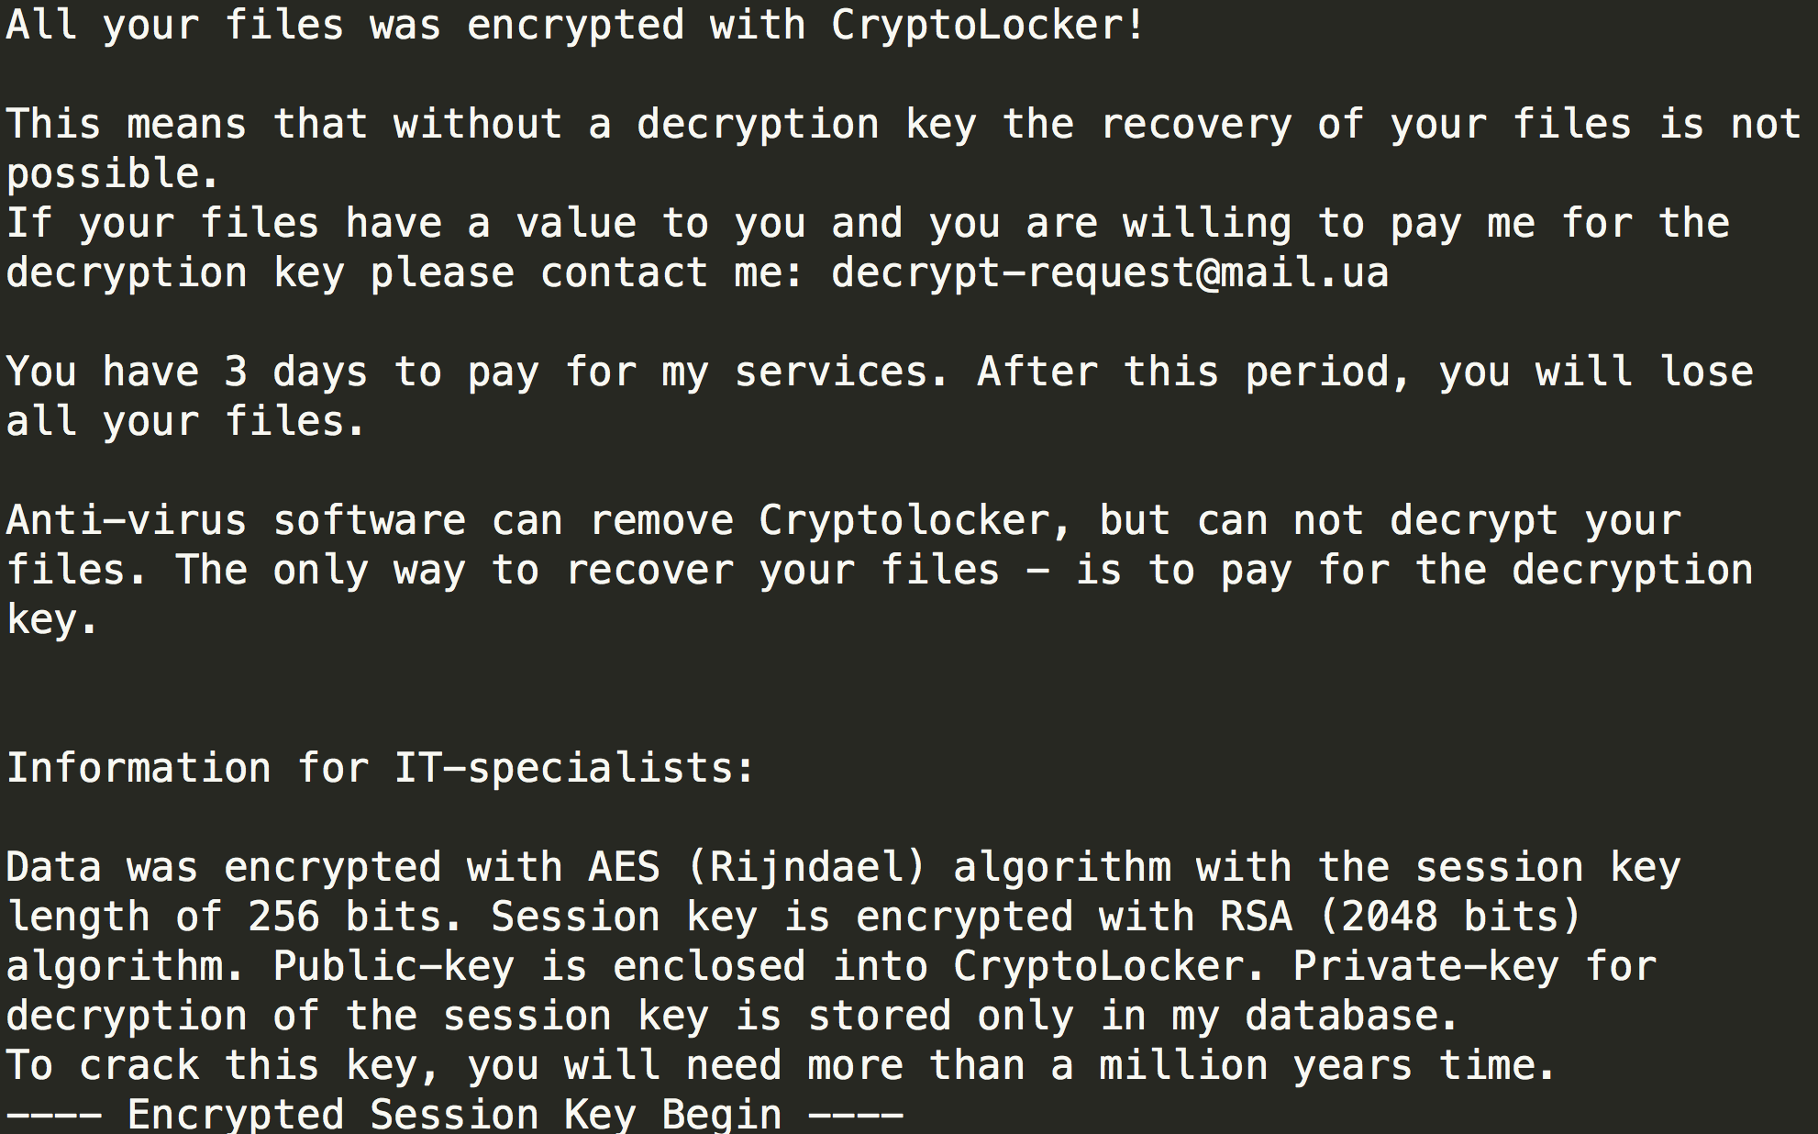

Slide 9
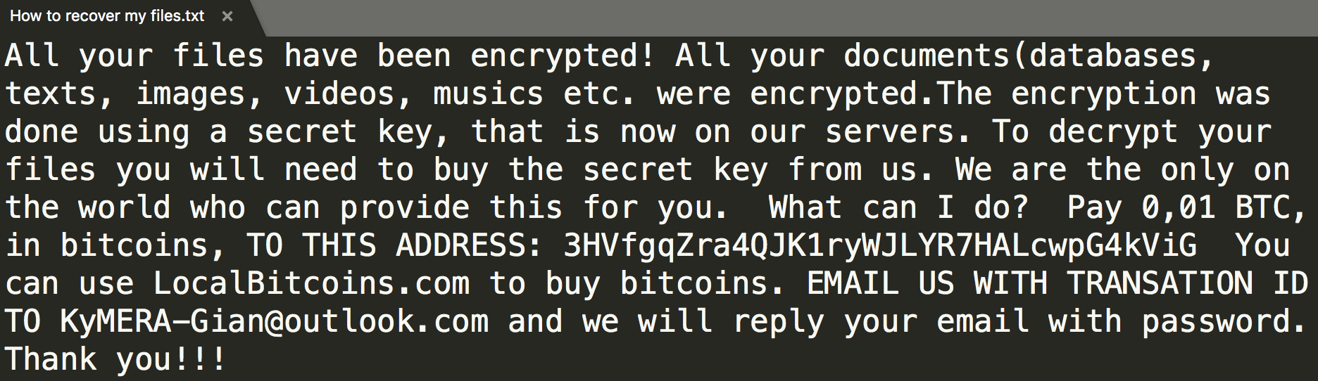

Slide 10
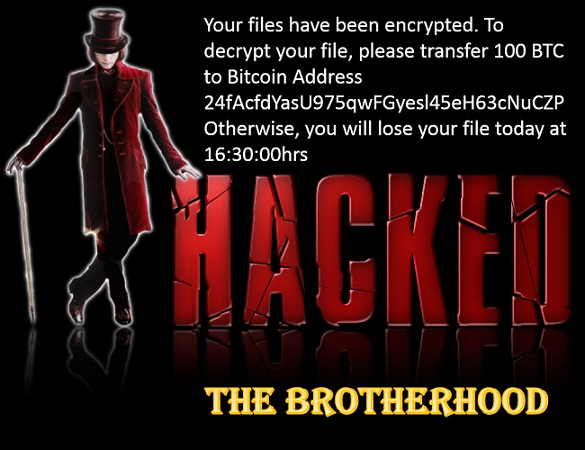

Slide 11
Ransom note template
Your files have been encrypted by [ransomware name]
Encrypted with [AES-256 / RSA-2048 / complicated crypto]
Your files cannot be recovered without a decrypter
Send [amount of cryptocurrency] to [wallet ID] to decrypt your files
Please contact [e-mail address]
You have [amount of hours / days] until your files will be lost

Slide 12

Exploratory research
Develop familiarity with data science concepts, tools
Collect ransom notes
Put together a base benign data set
Determine suitability of notes for classification

Slide 13
Exploratory research - TOOLS
Anaconda
Python 3
Jupyter Notebook
scikit-learn
spaCy

Slide 14
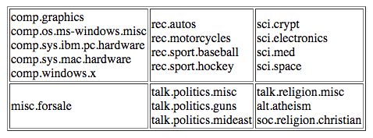
Exploratory research – DATASETS
Benign data
20 Newsgroups
11314 samples
Ransom notes
173 samples
Detonate ransomware samples and collect artifacts
Security research / blog posts
Download text notes
Extract text from screenshots with OCR

Slide 15
Exploratory research – APPROACH
Unlabeled data
Ransom notes and the 20 Newsgroups data
K Means Clustering
21 clusters
20 Newsgroups + ransom notes
Bag of Words
CountVectorizer
Term Frequency-Inverse Document Frequency (TFIDF)
TfidfVectorizer

Slide 16
Exploratory research – DATA PREP
Token Prep
Strip newline characters (‘\r’, ‘\n’)
Convert to lowercase
Tokenization
Alphanumeric characters only
Stop words
the, for, your
Lemmatize
encryption -> encrypt

Slide 17
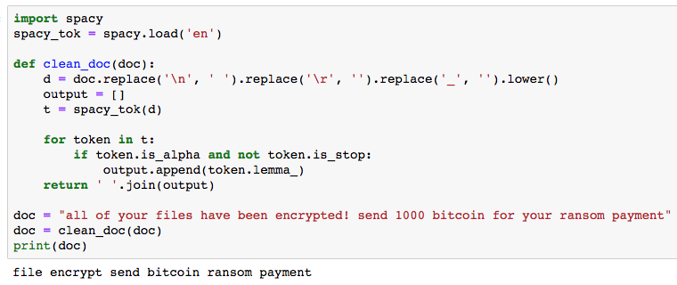

Slide 18
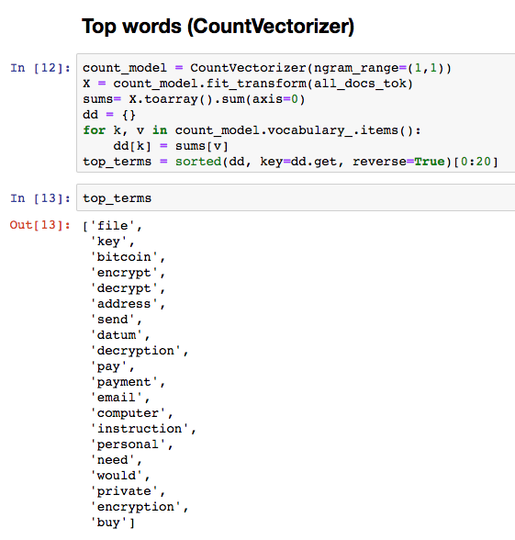
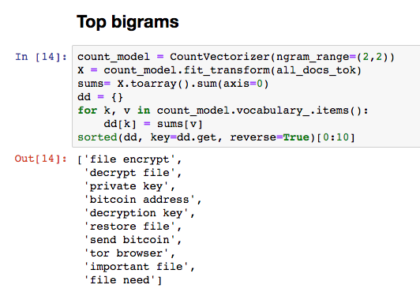

Slide 19
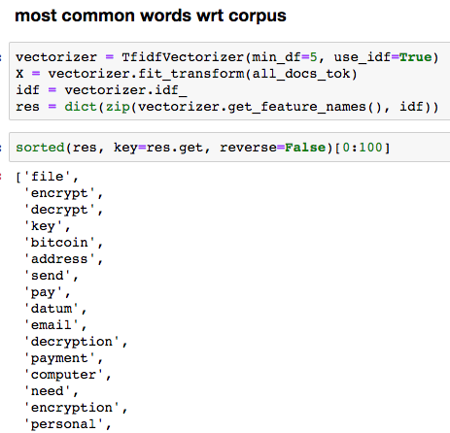

Slide 20
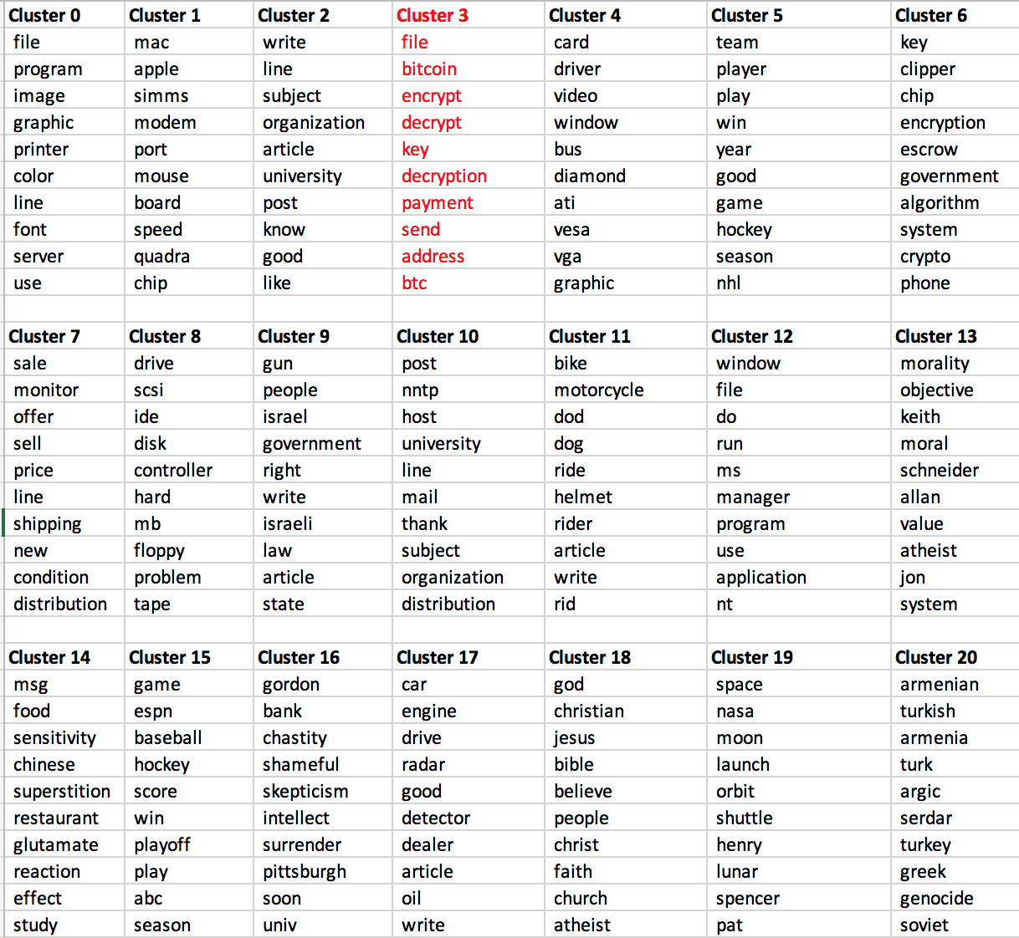
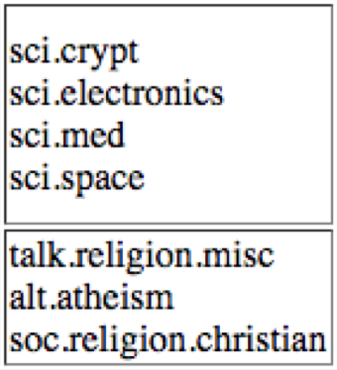
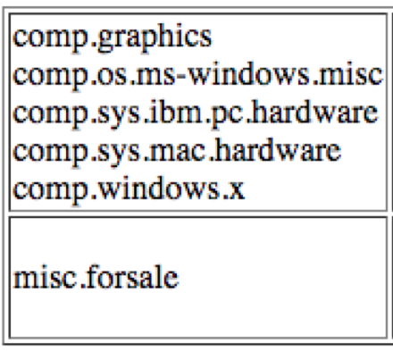
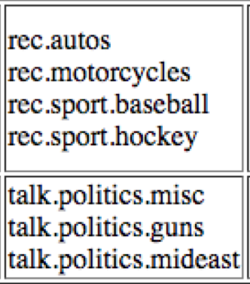

Slide 21
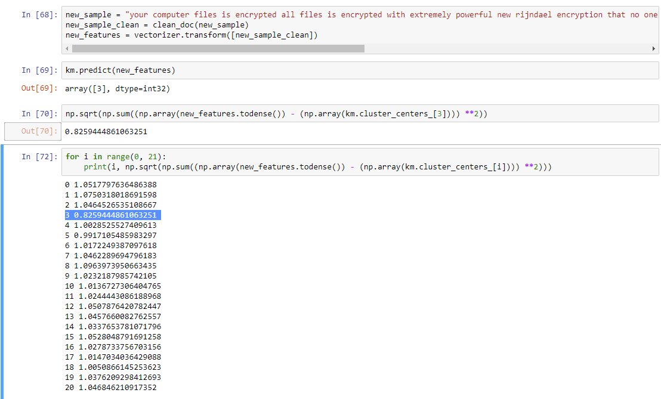
Calculate distance from the centroid for each of the clusters
Square root of the sum of squares

Slide 22
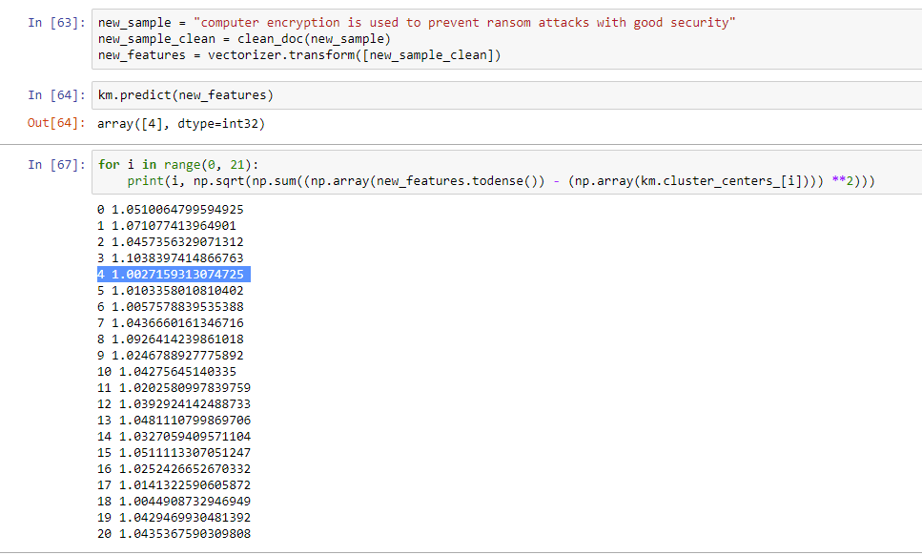
Phrasing doesn’t quite match that of a ransom note
Ends up in cluster #4 (comp.graphics)

Slide 23
Exploratory research – Results
Despite small set of data, ransom notes clustered together well
Demonstrated nuance in how the data clustered with second example
Dataset appears to be appropriate for classification

Slide 24
Framework - requirements
Obtain file change events in near real-time
Pass newly created text filepaths to a model
Read in file contents and determine if it is a ransom note
If text file is a ransom note, suspend source process

Slide 25
Framework - restrictions
English
.txt files only
Formatted text requires additional parsing
Images require OCR for text extraction
Only files < 20 KB
Ransom notes are generally < 2 KB

Slide 26
Framework - components
File change event listener (Process A)
Places new events into queue for Process B
Text extractor / standalone ML classifier (Process B)
Retrieves events from queue
Process mitigation handler (Process B)
Invoked if classifier determines file is ransom note

Slide 27
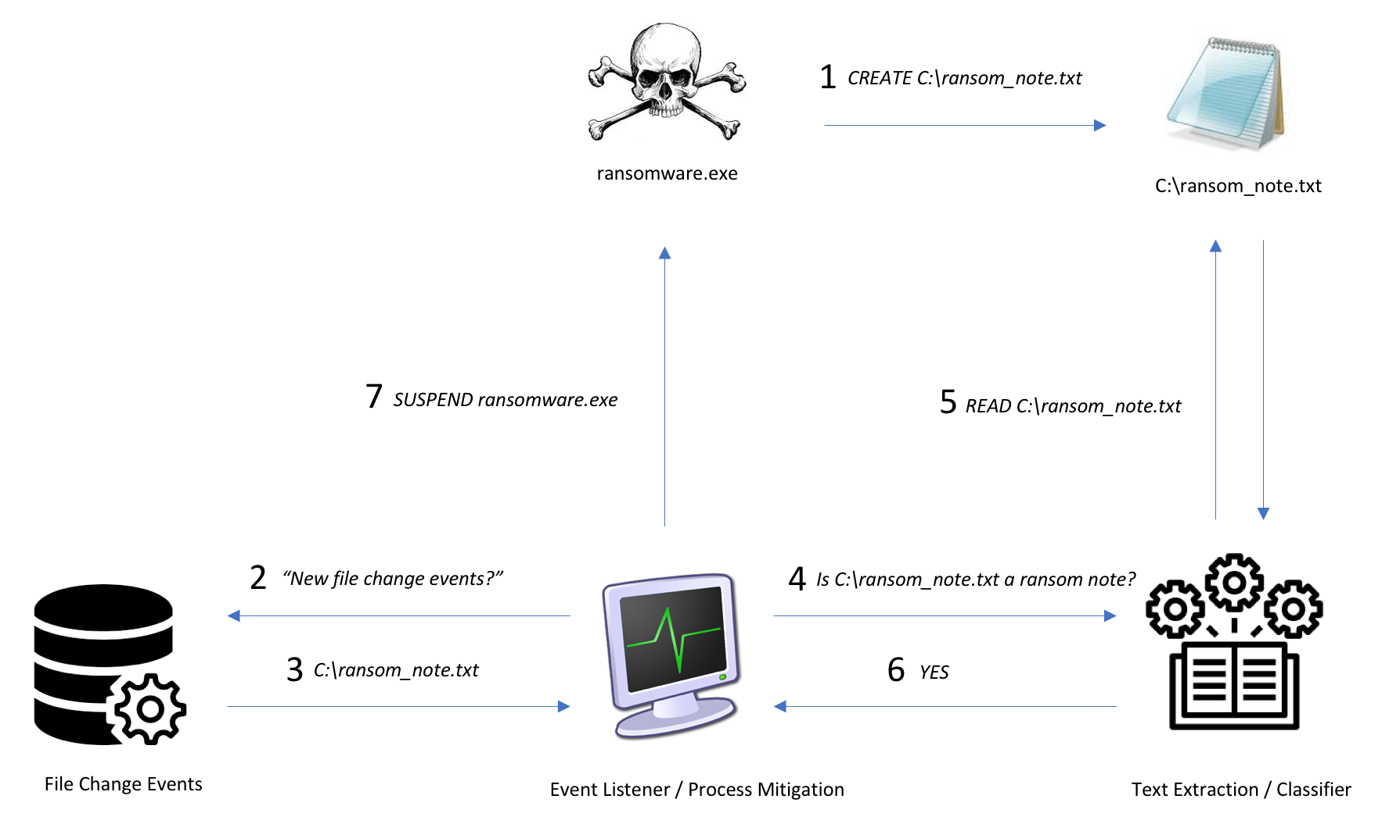

Slide 28
Expanded dataset
Benign
Subset of 20 Newsgroups: ~ 8000 messages
Windows text files: ~ 3000 files
Log files
READMEs
Total number of files: 11000+
Ransom notes
Total number of samples: 350+
Address Dataset Imbalance
SMOTE – Generate synthetic data

Slide 29
Classifier – APPROACH
Feature Selection via TFIDF
TfidfVectorizer
Supervised learning
Labeled data
Binary classification
Is this text a ransom note or benign data?
Naïve Bayes
Simple and straightforward
MultinomialNB

Slide 30
Classifier – DATA PROCESSING
Labeled Dataset
Pre-Tokenization
Ransom Notes
Strip Characters
Tokenization
Post-Tokenization
spaCy
Alphanumeric
Benign Text
Convert Lowercase
Strip Stop Words
Training
Dataset Balance
Vectorization
Lemmatization
MultinomialNB
SMOTE
TfidfVectorizer

Slide 31
Classifier – testing
Randomly partition into training (80%) and test (20%) subsets with train_test_split
Terminology
Accuracy Score
Accuracy classification score
F1 Score
Weighted avg of precision (TP / (TP + FP)) and recall (TP / (TP + FN))
Confusion Matrix
Matrix representation of true and false positives / negatives
Cross Validation
Test the model’s ability to predict new data that were not used previously
Multiple runs with different training and test data sets each time
Monte Carlo using ShuffleSplit

Slide 32

Classifier – SINGLE TEST
Accuracy – 99.54%
F1 Score – 91.86 (scaled to 100)
Confusion Matrix
TN = 2934 | FP = 14
FN = 0 | TP = 79

Slide 33
Classifier – CROSS VALIDATION
10 separate runs
Varying training / test data
Average Accuracy – 99.44%
Average F1 Score – 90.1
Average Confusion Matrix
TN = 2933.3 | FP = 16.5
FN = 0.5 | TP = 76.7

Slide 34
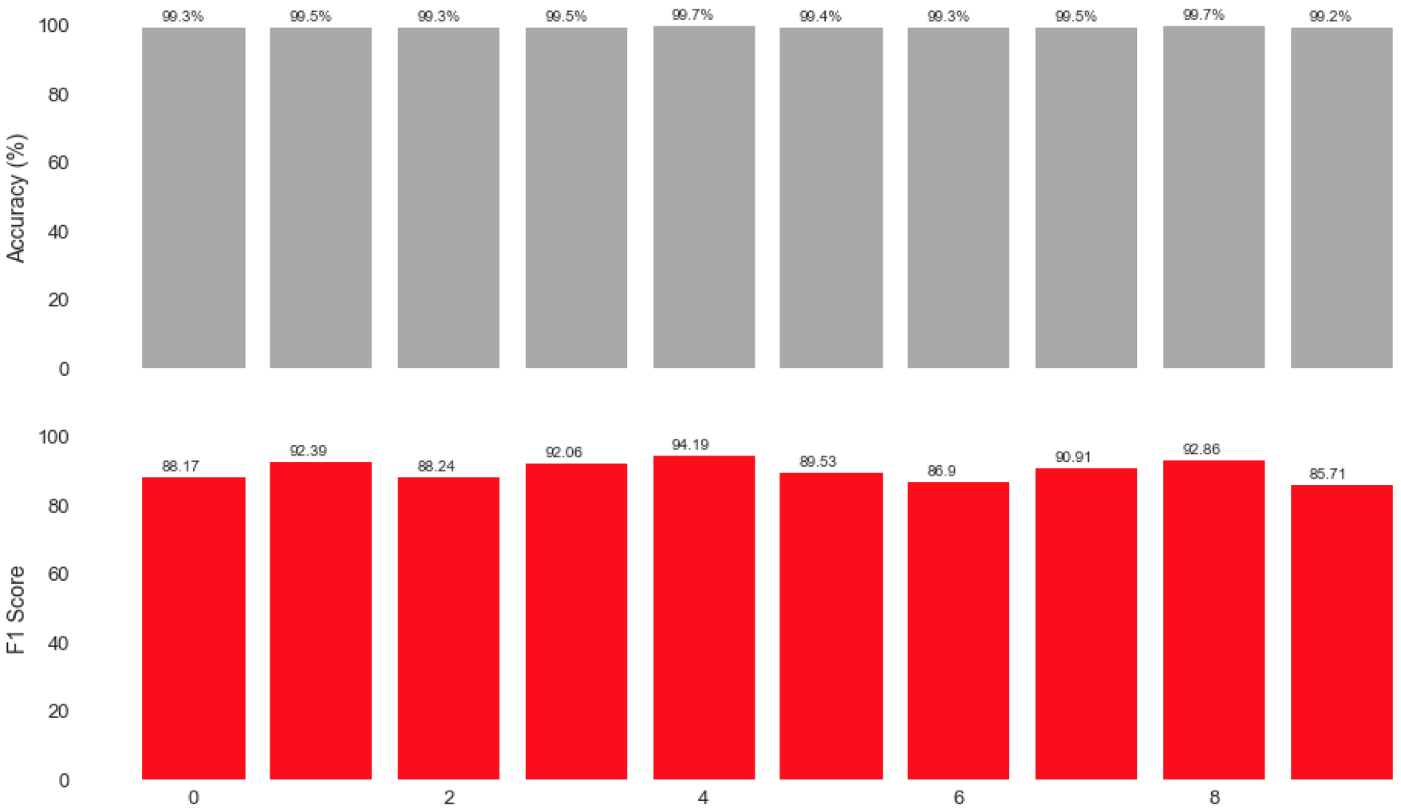
Breakdown of each of the 10 training / test iterations
I am not a data scientist, but I believe these are good results

Slide 35
Event listener - Approach
Monitor file change events
All processes
Map each event to source process
File creates in particular
python watcher
Event Logs
File minifilter driver

Slide 36
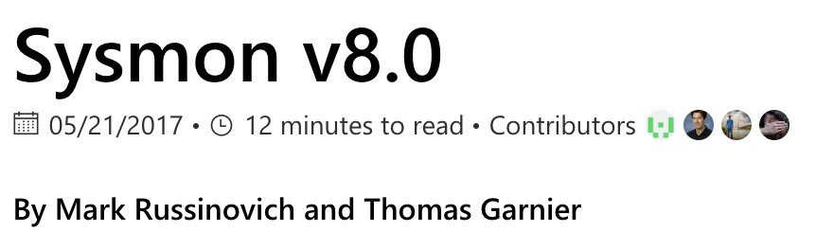
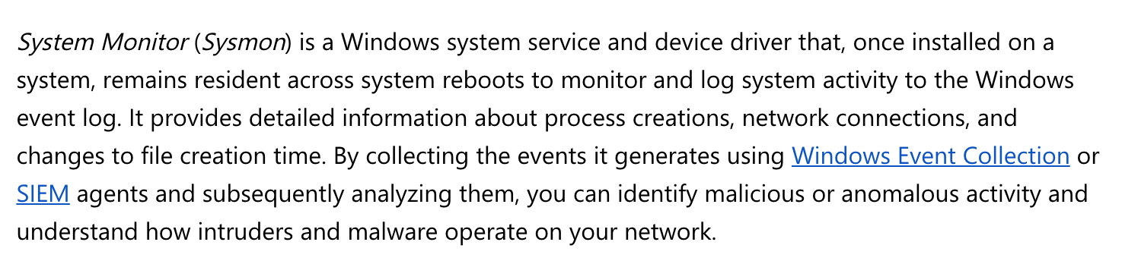
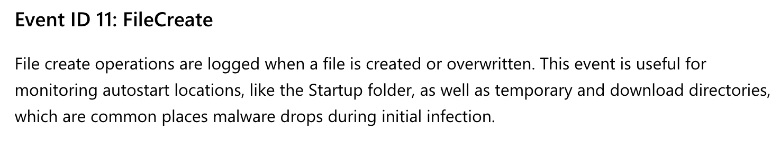

Slide 37
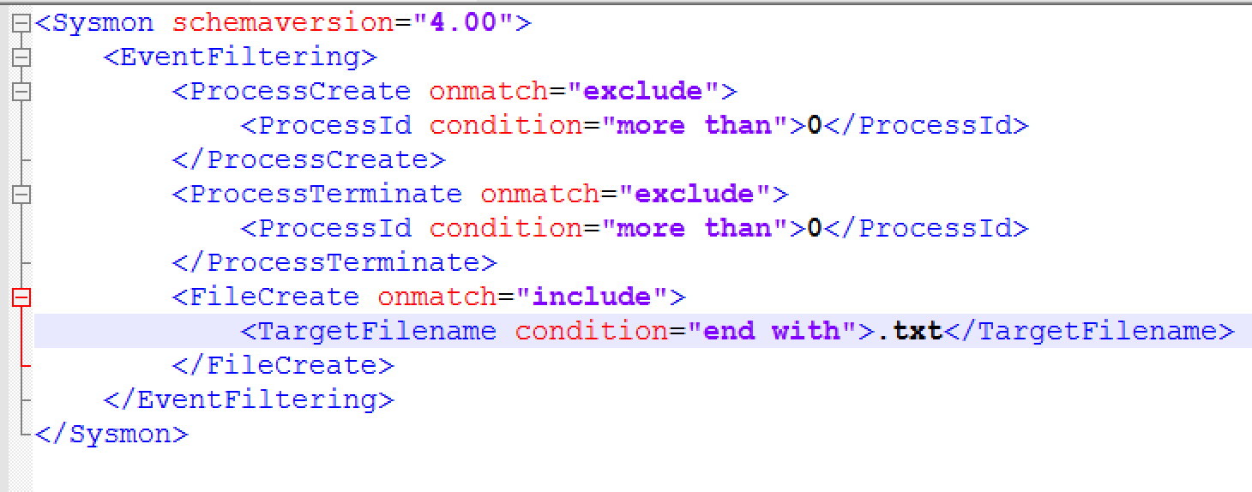
EVENT listener – sysmon install
sysmon.exe -i sysmon_config.xml

Slide 38
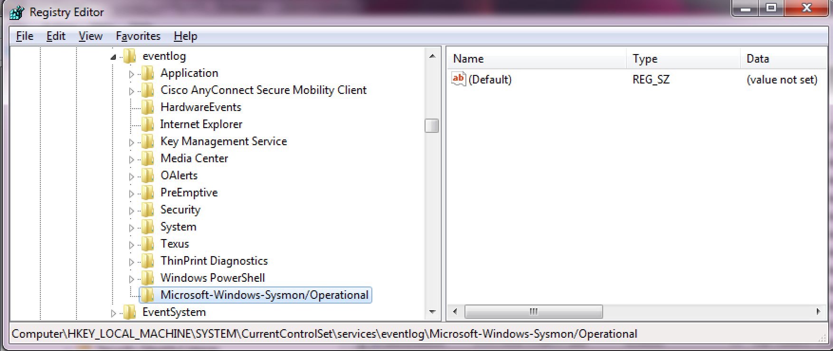
Event listener – sysmon config

Slide 39
Event listener – Event log polling
Poll event log for new files with WMI Query Language (WQL)
Limit size of result set (reduce overhead)
Parse data from results and insert into classifier work queue
SELECT * FROM Win32_NTLogEvent
WHERE LogFile = 'Microsoft-Windows-Sysmon/Operational’
AND EventCode = 11
AND RecordNumber > MaxRecordNumber

Slide 40
Process mitigation - APPROACH
Determine if process ID + process name exist
Suspend process if currently active
Alert user that ransom note was detected
Give user choice to terminate or resume process
Maintain whitelist of resumed process IDs + process names

Slide 41
LIVE DEMO (oh god please work)

Slide 42
Framework – Results
Tested / detected 9 holdout samples
TQV
GlobalImposter
BTCWare
Everbe
Volcano
Rapid
Gandcrab
Painlocker
Tested / detected 3 samples with notes in training set
Sigrun
Josepcrypt
WhiteRose

Slide 43
Framework – Comparative Results
Compared results to three free or trial-based products (A, B, C)
Two types of tests:
Test 1: Does product detect sample?
Test 2: Does product detect faster than the classifier framework?
Product running side-by-side with classifier framework
Rough estimate of detection speed / performance
Potential complicating factors (e.g. driver altitude)

Slide 44
sha256 | family | A1 | A2 | B1 | B2 | C1 | C2
d9a1afc8536fb2bb27e7155d8506baf1ff38ffd5dd12a84b50e63c94b961f553 | TQV | Y | N | Y | T | N | -
dd0dac4f68871681ea3b149df9741d0a81c5635bc8bf23d800c245078678daad | GlobeImposter 2.0 | Y | N | Y | Y | N | -
22f31d9dd79d7d30ab5c106971d49038401c347f4a438b1348e71d223fe3ef61 | BTCWare | Y | N | Y | Y | Y | Y
14633206a2b1e42d5a960eef94e957100204289333fc60fddc7f704327fec65e | Everbe2 | Y | N | Y | Y | N | -
b8817615183ddb75f8768528d78b87bafadbb0dbcb8a22e8c9aeea74da18cbf7 | Volcano | Y | N | Y | T | N | -
1db83903514d064201d54bf2fbb2dab9a373c3c399be45be1ecaf4559c6ed16b | Rapid3.0 | Y | N | Y | N | Y | Y
ce093ffa19f020a2b73719f653b5e0423df28ef1d59035d55e99154a85c5c668 | Gandcrab | Y | N | Y | Y | Y | Y
d9ea37b43b597340d1430f3b97cb72d84ef88aeb559acf868dfd0a73de4f45f8 | PainLocker | Y | N | Y | Y | Y | Y
f4d7c88f319414a187671ae60c1e4a3c912188996913db35fa563c56a0f956fb | Sigrun | Y | N | Y | T | Y | Y
c6ffb93f9308d29e6776699c8c0833f25b737c9a5f8b241ddf1f386570c4661d | JosepCrypt | X | X | Y | T | N | -
62c05d926d4e3ecc04896e48168cdd7ca4375f3e883d5ed0bf5deaf80d294305 | WhiteRose | Y | Y | Y | Y | Y | N
“Y” = Yes; “N” = No; “T” = Tie; “-” = test omitted due to prior result; “X” = ransomware crashed before any detections
Product B performed best and was typically faster than our framework
Framework detections lagged behind by a second or two at most
Framework handily outperforms Product A and Product C

Slide 45
Framework - limitations
Samples that don’t drop .txt ransom notes
Samples that drop ransom notes late
Samples that persist and respawn
Samples that attack system in other ways
MBR
Raw disk / FDE
screen lockers
Only English

Slide 46
Framework – future work
Improve the datasets
More ransom notes / less synthetic data
New ransom notes
More representative benign text data
Port codebase to C / C++
Significant performance improvements
Add parsers for other file types
Expand language support
Experiment with different classification approaches

Slide 47
conclusion
Clustering proved suitable for classification
Ransom notes share enough features for proposed solution to be viable
Won’t catch all ransomware
Integral piece of layered detection
POC works!
Many improvements to be made

Slide 48
SPECIAL THANKS Bobby Filar Endgame Research Team Ransomware Research Community github.com/endgameinc/noteclass mager@endgame.com @magerbomb

